Slide 1


Science
Scientists and Inventors
Year One
Subject | Year 3 | Scientists and Inventors | Fossil Finders | Lesson 4

Slide 3
Aim
To explain how fossils can be used to find the age of rocks.
Success Criteria
I can describe how scientists use fossils to date rocks today.
I can explain what William Smith discovered about rocks and fossils.
I can use William Smith’s ideas about fossils to put rocks in age order.

Slide 4
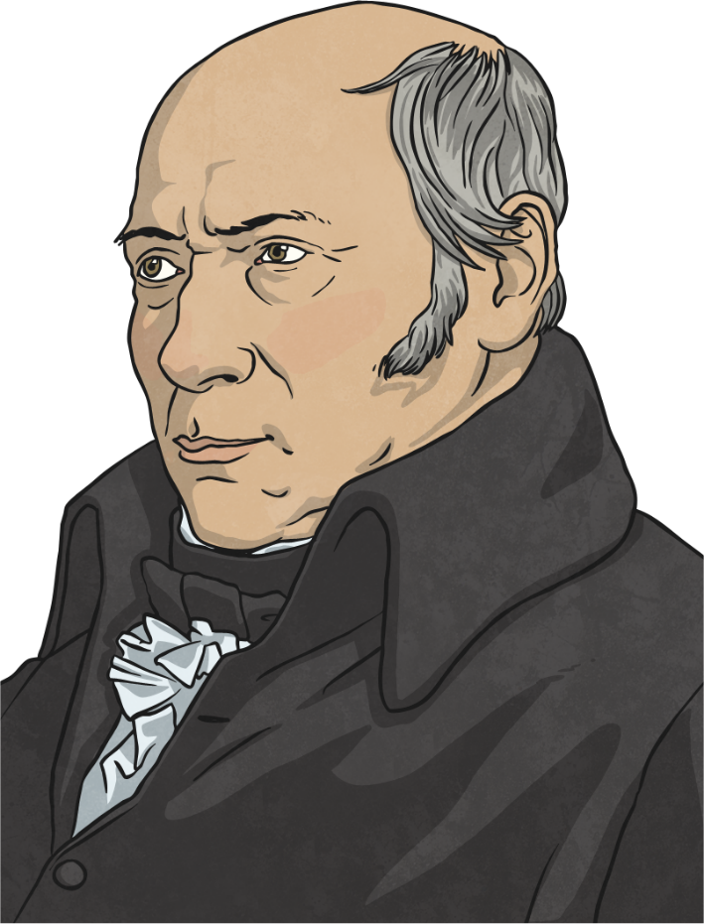
William Smith
William Smith was born in 1796 in Oxfordshire. Although he did not enjoy early recognition for his scientific work, by the time he died in 1839 he had been awarded the Wollaston Medal and was known as the 'Father of English Geology'. Geology is the name for the study of rocks.

Slide 5
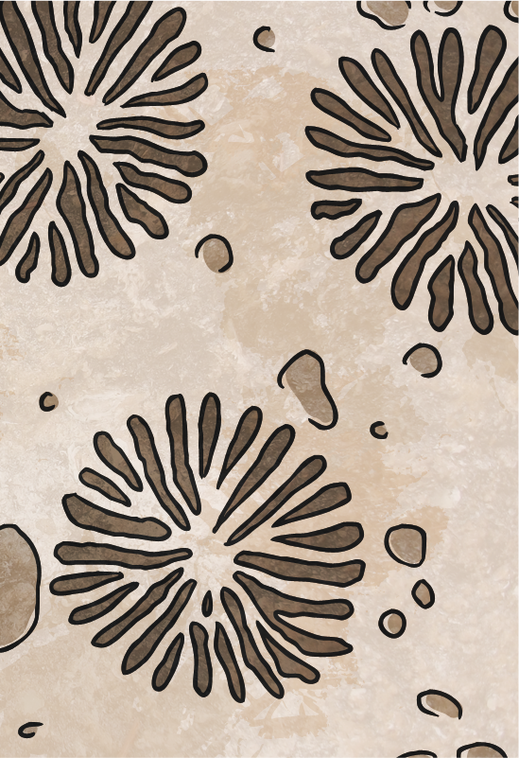
William Smith
William's job as a surveyor meant that he had to examine the rocks around where he was working in great detail. He collected fossils that he found from his work sites, and he began to notice a pattern.
He noticed that the fossils found in sedimentary rock were always in a regular pattern from the bottom to the top of the layers of rock. He decided to search the whole country to see if this was the same everywhere in England.
He found that his ideas were correct, and fossils were in the same order in the rocks across the whole country. He realised that he could tell the age of a rock by looking at the fossils inside it.
He recorded his findings and used them to produce the first geological map of Britain, showing the age of the rocks on the ground around Britain.

Slide 6

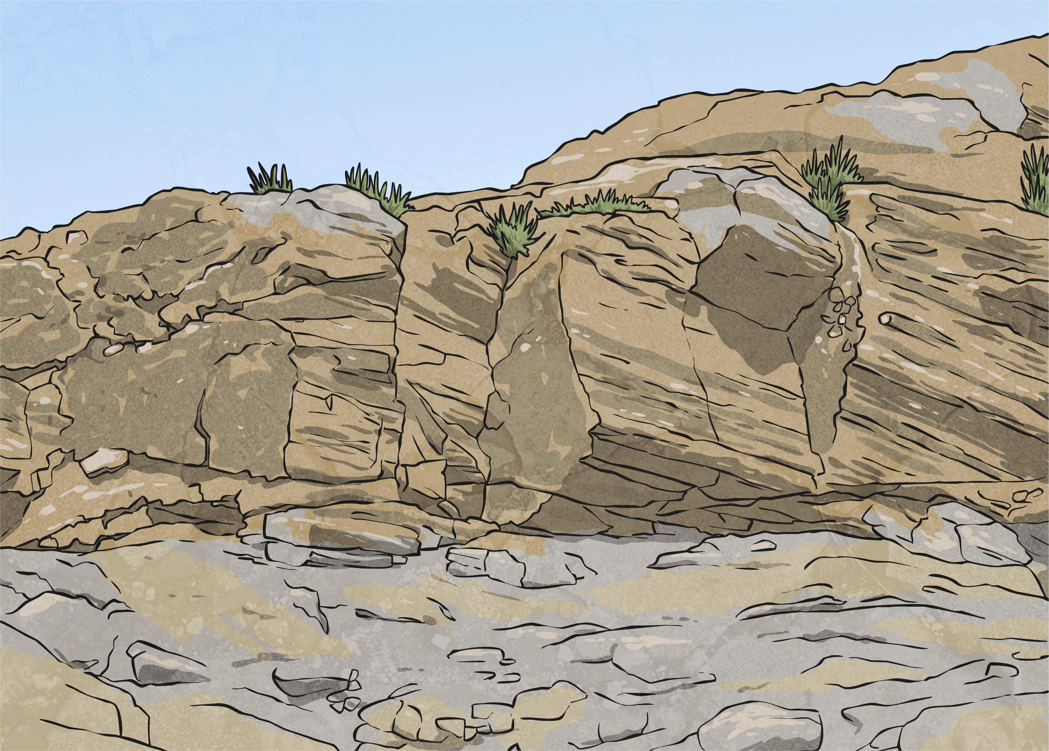
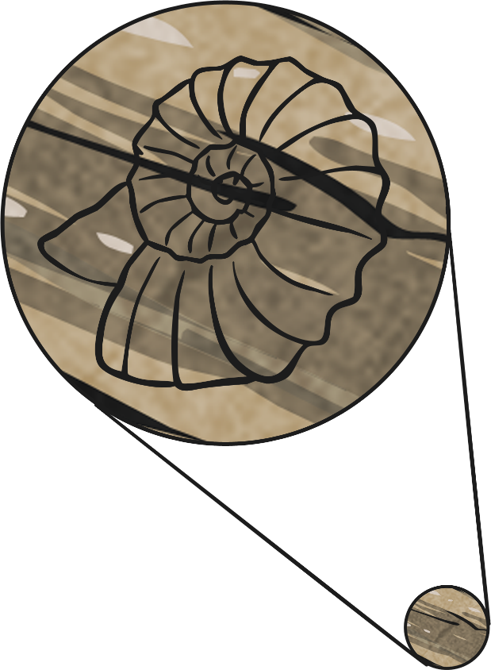
Sedimentary Rocks
William Smith studied the fossils that he found in the layers of sedimentary rocks.
What are sedimentary rocks?

Slide 7
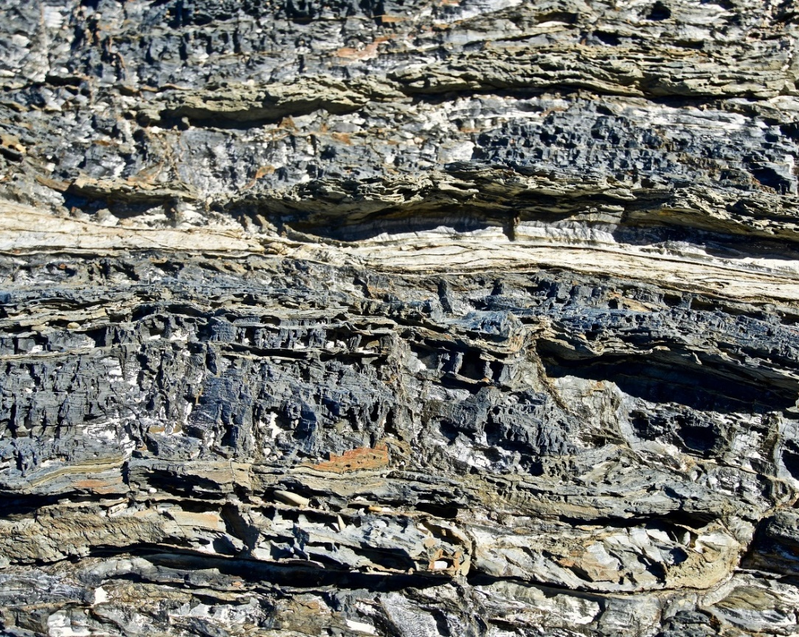
Sedimentary Rocks
Sedimentary rocks are formed by small particles of other rocks, minerals, plants and organic matter that are deposited over time, often at the bottom of a sea or lake.
These particles are known as sediment. The sediment is compressed, or squashed down, over many years before it forms into solid layers of rock.
Sedimentary rocks form layers which are known as strata. These layers can be seen in exposed cliffs.

Slide 8

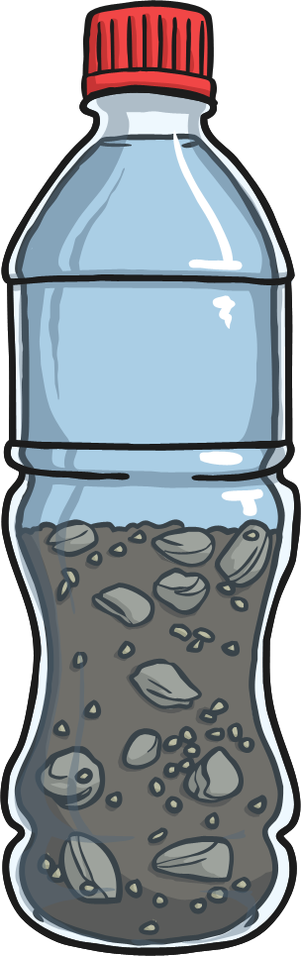
How Are Sedimentary
Rocks Formed?
Try this activity to see how sedimentary rocks are formed.
You should see results by the end of the lesson!
Mix two tablespoons each of gravel, sand, soil and stones in a bag. These materials are like the particles or sediment that is deposited in seas or lakes.
Make sure the different materials are thoroughly mixed. Then pour them into a clear plastic bottle or beaker.
Pour water over the sediment. This is like the water in the seas or lakes.
Now, leave the beakers or bottles somewhere that they won't be disturbed.
Check them at the end of the lesson.

Slide 9
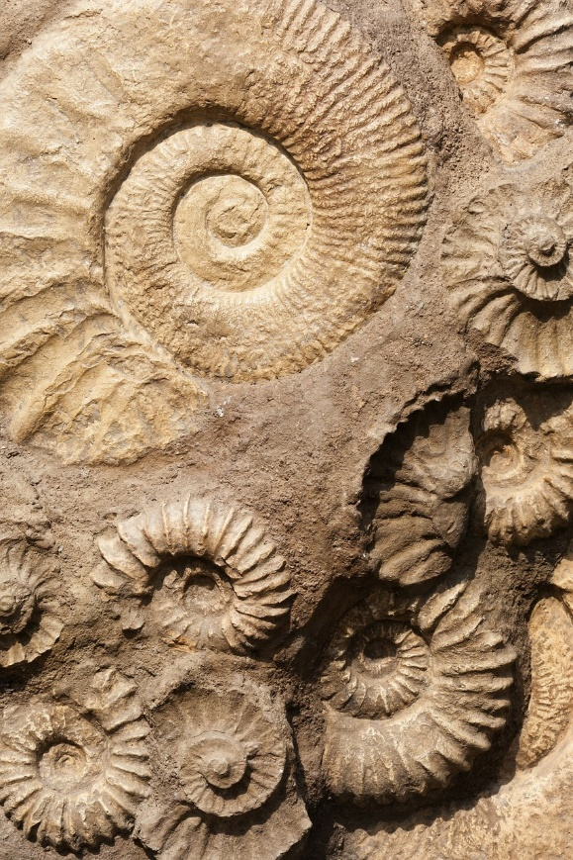
Fossils
William Smith noticed that the fossils found in the strata of sedimentary rocks were always in the same order from the bottom to the top. He called this the 'Principle of Fossil Succession'.
The layers of sedimentary rocks in a particular location contain fossils in a definite sequence, with the oldest fossils at the bottom and the youngest fossils at the top.
William realised that the types of fossils found in rocks could be used to find out the relative age of the rocks. For example, if the layers in a rock contain fossils from the Cretaceous and Jurassic periods, then the rock is younger than one containing fossils from the Devonian and Silurian periods.
youngest
oldest

Slide 10
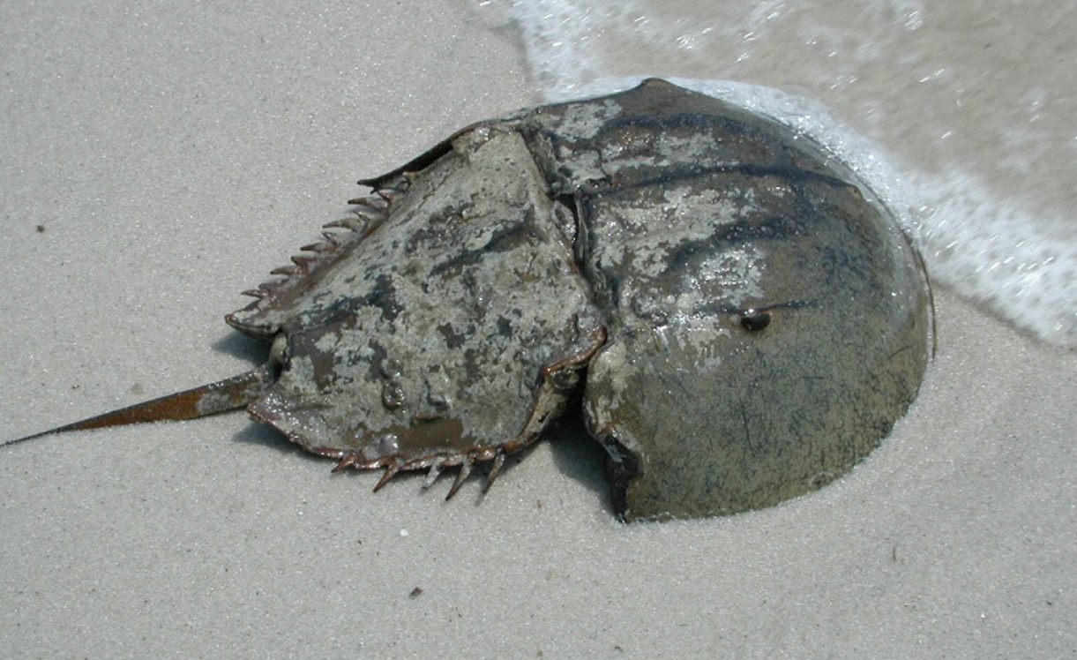
Fossils
However, he could not just use any fossils to find the age of rocks. Some animals and plants lived for a very long time, so their fossils would be found in lots of layers and would not help him. For example, horseshoe crabs have existed for 400 million years and are still alive today! Their fossils will be found in many different layers of rock.
William realised it would be better to use the fossils of plants and animals that only existed for a short time, as the fossils are only found in single layers of rock.

Slide 11


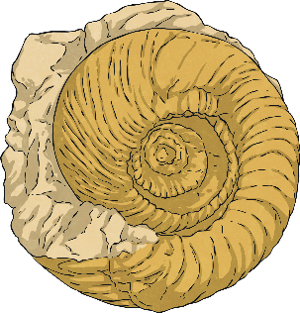
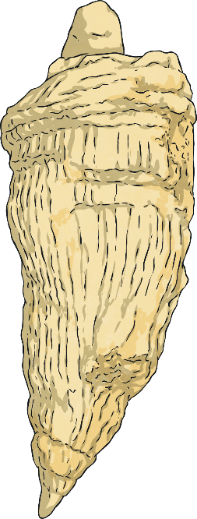

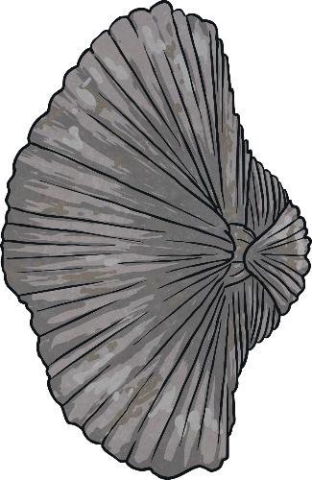
Index Fossils
The fossils that are used to find the age of rocks are known as index fossils.
Your Index Fossil Fact Sheet shows you the index fossils and the time period each one is from.
?
If William found a fossil like this one inside a layer of rock, which time period would it be from?

Slide 12
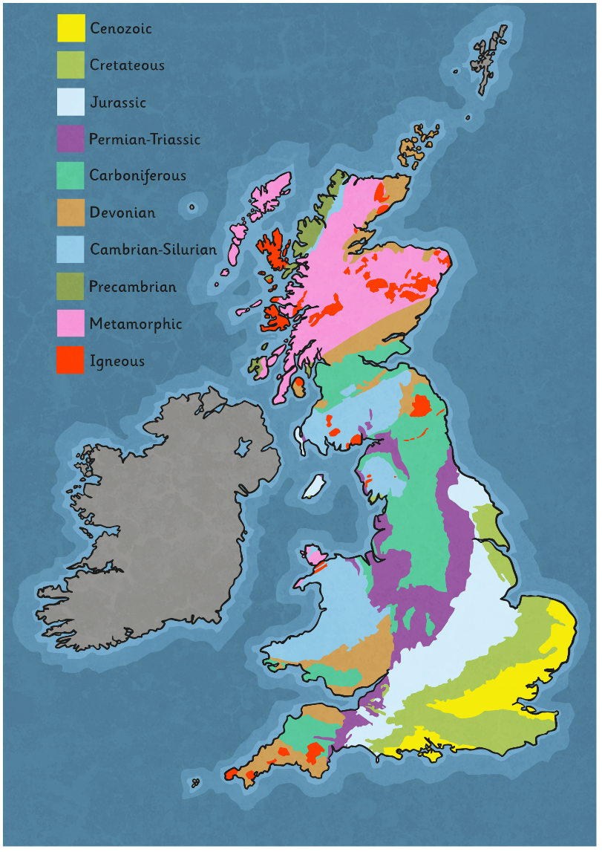
Geological Map
William Smith was the first person to create a geological map of England.
A geological map shows the ages and types of rocks found in a particular area.
He created his map by touring Britain and identifying the fossils found in the surface rocks. He used these fossils to find the age of the rocks in the different areas he visited.
The colours on this geological map show the different types and ages of the surface rocks around Britain.
?
Where can you find rocks from the Cambrian and Silurian time?
?
Can you name two types of rocks that are found in Scotland?

Slide 13

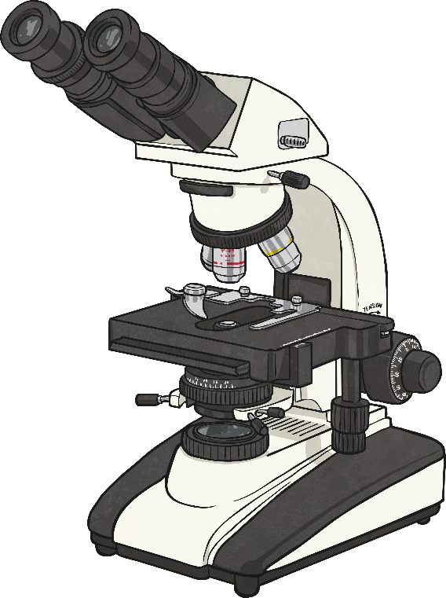
How do Scientists Use Fossils Today?
Today, scientists like Dr Lisa White use tiny microscopic fossils, called microfossils or nanofossils, to find the age of rocks and soils.
Because the first life on earth was made up of tiny creatures, so small that we wouldn’t be able to see them, Dr White has to study their tiny fossils with a microscope to date the oldest rocks and soils on the planet.

Slide 14
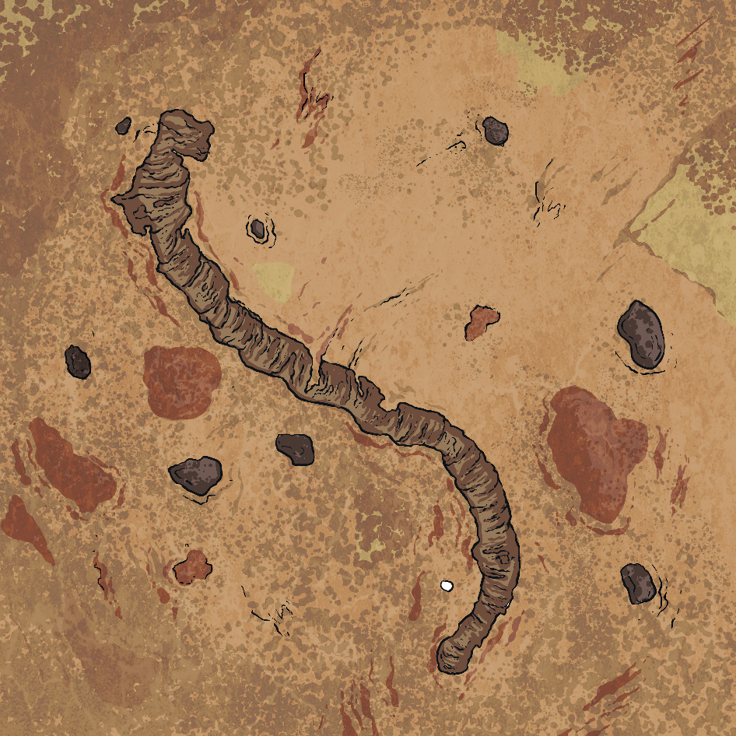
How do Scientists Use Fossils Today?
In 2017, tiny fossils were found in Australia that are thought to be 3.5 billion years old!
Fossils today tell us about the animals and plants that have lived on earth that we might not know about otherwise.
They also tell scientists about changes to the land and climates on earth.

Slide 15
Sedimentary Rocks Bottle
Check the bottles or beakers you set up earlier in the lesson.
?
What do you notice?
You should see that the different particles have separated into separate layers.
This is just like the layers or strata that form to make sedimentary rocks, the types of rocks in which fossils are most likely to be found.

Slide 16

Aim
To explain how fossils can be used to find the age of rocks.
Success Criteria
I can describe how scientists use fossils to date rocks today.
I can explain what William Smith discovered about rocks and fossils.
I can use William Smith’s ideas about fossils to put rocks in age order.

