Slide 1

Springwood Heath
‘Success through Caring and Learning.’
KS2 SATs 2023

Slide 2

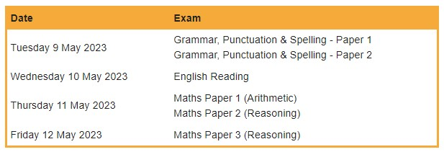
Timetable 2023
Consider the impact of SATs tests straight after a bank holiday.
It is hoped that (together with the 2022 SATs) the 2023 SATs will show the impact that the 2020and 2021 school closures had on children's learning.

Slide 3
SATs since 2016
In the summer term of 2016, children in Y2 and Y6 were the first to take new SATs tests.
The current SATs for English and maths reflect the updated national curriculum, and are more rigorous than previous years’ tests.
There is also a completely new SATs marking scheme and grading system which has replaced national curriculum levels.
In 2018 the Department for Education announced that the reading content of KS2 SATs will be closely linked to the curriculum in future years to ensure children are drawing on their knowledge when answering reading comprehension questions.

Slide 4

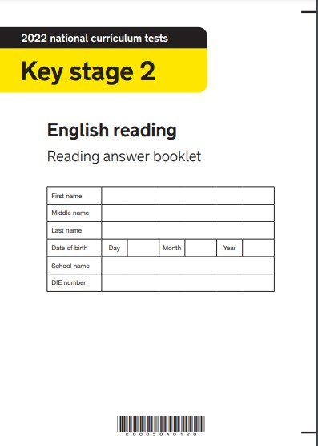
KS2 SATs Reading Paper
The reading test is a single paper with questions based on three passages of text.
Your child will have ONE HOUR, including reading time, to complete the test.
There will be a selection of question types.
Children can approach the texts in any order.
3 extracts: the ratio is 2:1 (2 fiction for every non-fiction)
The three extracts get progressively more demanding
Maximum marks = 50
The Questions will assess the KS2 Content Domains

Slide 5
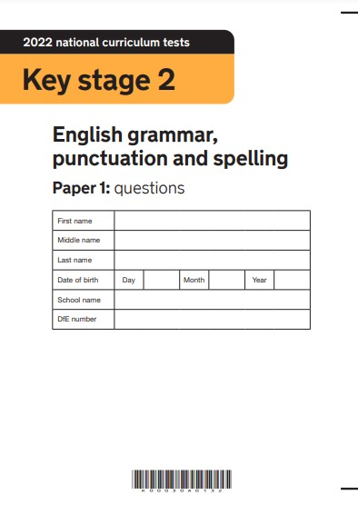
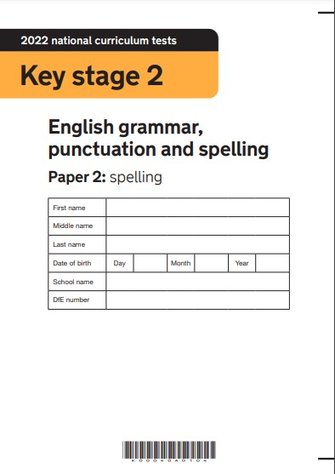
KS2 Grammar, Spelling and Punctuation
The SPaG test consists of two parts:
a grammar and punctuation paper requiring short answers, lasting 45 minutes,
an aural spelling test of 20 words, lasting around 15 minutes.

Slide 6
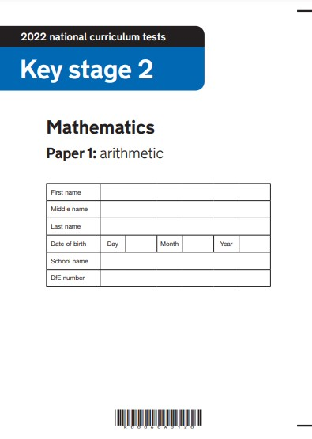
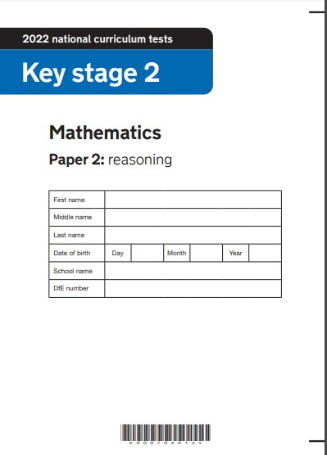
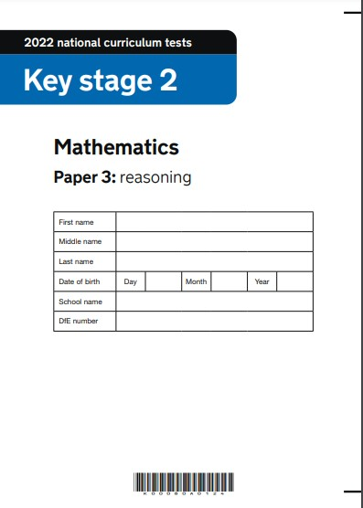
KS2 Maths
Children sit three papers in maths:
Paper 1 (arithmetic, 30 minutes),
Papers 2 and 3 (reasoning, 40 minutes each).

Slide 7
Maths Walk Through Videos
Walk Through Videos

Slide 8
Free Practise Tests Online
2022 key stage 2 test materials
2021 NO SATs
2020 NO SATs
2019 key stage 2 test materials
2018 key stage 2 test materials
To help prepare children for the 2023 Key Stage 2 SATs, you are able to download the 2022, 2019, 2018, 2017 and 2016 papers free of charge.
All past papers include an English reading paper, a full set of mathematics papers and the short answer questions in the grammar punctuation and spelling paper.
NOTE: 2016 saw the start of new-style SATs
SATs-PAPERS.co.uk Free SATs papers online
GOV.UK

Slide 9
KS2 Science
Ministers have decided not to undertake any further science sampling tests at KS2 from September 2022 onwards.
Schools will still submit teacher assessment data at both KS1 and KS2.

Slide 10
Marking and Reporting
Children are given scaled scores and details of whether they’ve reached the expected standard (‘NS’ means that the expected standard was not achieved; ‘AS’ means it was).
The scaled scores for the KS2 test range between 80 (the lowest possible scaled score) and 120 (the highest possible scaled score). The expected standard for each test is a scaled score of 100 or more. The Department for Education expects at least 65 per cent of Y6 children to reach the expected standard.
Every school's performance will be made public in December 2023 to create the 2023 school league tables.

Slide 11
KS2 SATs Results and Secondary Schools
Almost all secondary schools group children into sets or streams based on their academic ability, and SATs results may be used as part of the decision-making process.
That said, because children are only assessed in English and maths, and in particular skills within these subjects, it’s common for secondary schools to use their own tests (such as Year 7 CATs) as part of the setting process.
The results of these tests may be used on their own, or alongside SATs results, to determine which ability group a child ends up in.
Secondary schools also use SATs results to work out their Progress 8 score. This is a performance measure of how well pupils progress between Year 6 and Year 11, with their SATs results as a starting point.
Progress 8 scores give a picture of attainment across the entire year group, rather than on a child-by-child basis, and are used to place secondary schools in national league tables.
Some secondary schools will set targets for your child based on their KS2 results. These may be GCSE targets or interim targets for the end of each year. However, most schools will take other factors into consideration when target-setting, as well as KS2 results.

